Slide 1
BTEC Level 3 National Extended Certificate in Construction and the Built Environment
Worth 60 Credits Equivalent to 1 A-Level

Slide 2
Key Features
l will provide opportunities for learners to achieve a nationally recognised Level 3
vocationally-specific construction, civil engineering or building services qualification
could provide opportunities for learners who are already in, or about to enter into, employment to
work towards the achievement of an apprenticeship in their sector, or to progress to further education
vocational qualifications
will provide education, training and the application of knowledge in technical areas that are directly
relevant to the changing needs of construction, planning and the built environment employees,
employers and professions
will provide learners with enhanced knowledge and understanding of the key issues of health, safety and
welfare in the construction, planning and built environment industries
will provide learners with enhanced knowledge and understanding of the key issues of sustainability in
the construction, planning and built environment industries
will provide opportunities for learners to develop a range of skills and techniques, personal qualities and
attitudes essential for successful performance in working life and career development (PLTS)

Slide 3
Summary
The Extended Certificate is for learners who are interested in learning about the construction sector alongside other fields of study, with a view to progressing to a wide range of higher education courses, not necessarily in construction-related subjects.
It is designed to be taken as part of a programme of study that includes other appropriate BTEC Nationals or A Levels.

Slide 4
Units of Work – 60 credits
Students must complete 4 units over the 2 year period, 4 are mandatory and 2 are external. Mandatory content = 100%, External Content = 66%.

Slide 5
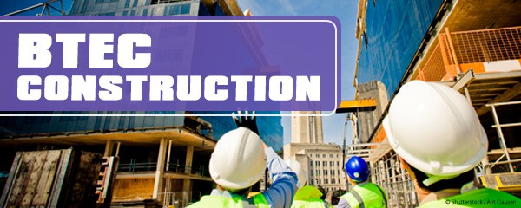
External Assessments

Slide 6
Units of Work
Unit 1: Construction Principals:
Learners demonstrate an understanding of the underlying principles used in the design, construction and refurbishments of buildings and infrastructure. In this unit, you will develop the skills needed to solve a variety of practical construction problems by applying scientific knowledge and carrying out mathematical and statistical techniques. You will
learn about the science underpinning the manufacture, properties and degradation of construction materials. You will apply mathematical principles and techniques to carry out calculations that determine how materials behave under the action of forces or loads when used as structural members, and draw conclusions regarding whether a material is fit for purpose. You will understand scientific principles and apply them to heat loss, sound reduction and lighting levels to provide human comfort during structure design, build and refurbishment.
Unit 2: Construction Design:
Learners will apply the principles and practice of design and construction for low- and medium-rise buildings and structures. In this unit, you will learn the principles and practice involved in the design and construction of low- and medium-rise buildings and structures, and gain an understanding of how design is influenced by client requirements and external constraints. You will consider the stages involved in the design and construction process and gain an understanding of the use of design techniques, including sketching and computer-aided design (CAD) to provide efficient methods of designing, constructing and maintaining structures over their life cycle. To complete the assessment task within this unit, you will need to draw on your learning from across your programme.
Unit 4: Construction Technology: Learners examine the underlying principles and construction methods used in the construction of new buildings and their associated external works.
Unit 5: Health and Safety: Learners will carry out a safe system of work and investigate the significance of safety system reviews, understanding the responsibilities of employees and employers with regard to health and safety in construction operations.

Slide 7
Post 18
University courses such as:
Property and construction
Construction management
Building, engineering and materials
Construction business and management
Engineering
Quantity surveying and commercial development
Construction Business and Project management – UUJ
Construction Engineering and management – UUJ
Energy and Building Services Engineering – UUJ
Product and Furniture Design – Belfast
Quantity Surveying and Commercial Management – UUJ
Environmental Planning – Queens
Land Use and Environmental Management – Queens

